Slide 1

Hierarchical Linear Models with PyMC3
Paul Black - Junior Data Scientist DRIVIN
Metis - Chicago -2018
Paul.laifu.black@gmail.com
linkedin.com/in/paulfblack
github.com/paulfblack

Slide 2


Slide 3

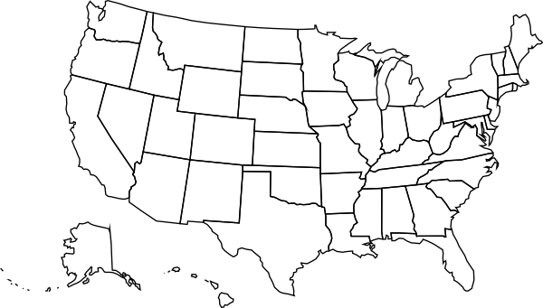

Hierarchical Modeling
Hierarchical modeling is a tool of probabilistic programming and Bayesian statistics which predicts the parameters of a posterior distribution for data which can be observed on multiple levels.
It allows for between group varying slope and varying intercept bounding the parameters between complete and no pooled alternatives.

Slide 4
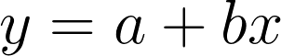
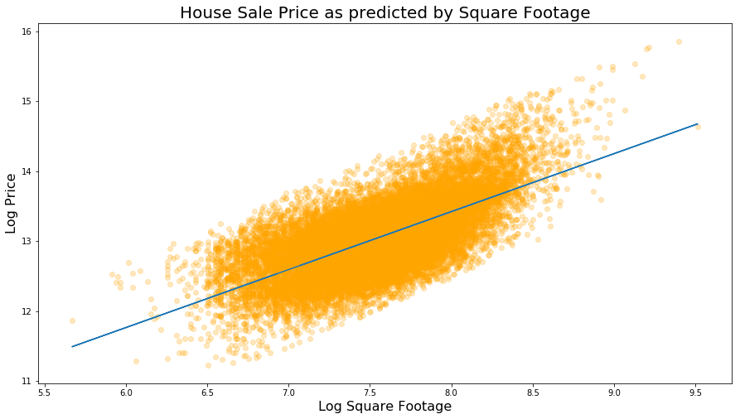
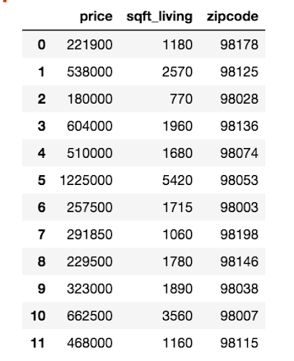
Case Study: Historical Housing Sale Data in Seattle
Intercept: 6.78846662885 Slope: 0.829001511752 R2: 0.463386928112
Data source: https://www.coursera.org/learn/ml-foundations/supplement/RP8te/reading-predicting-house-prices-assignment

Slide 5
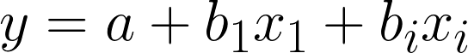
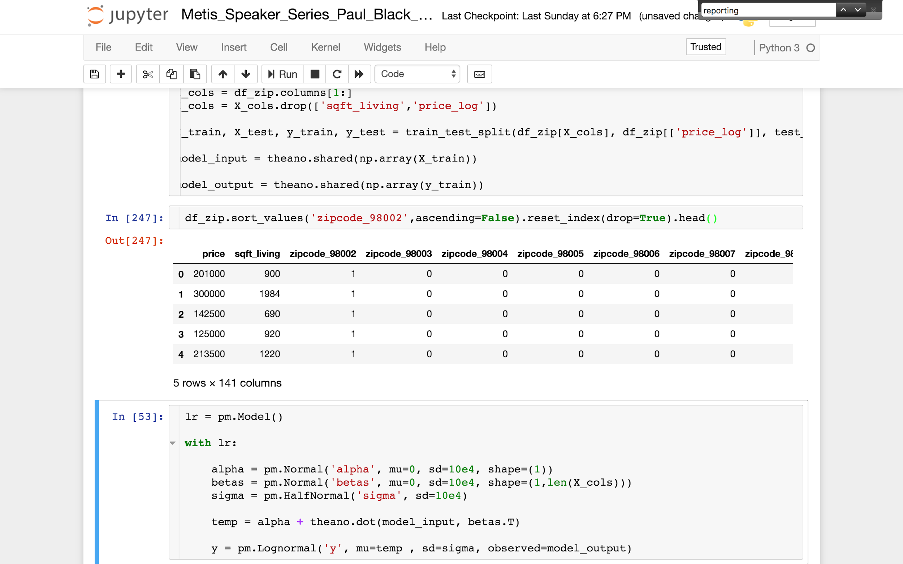
Case Study: Historical Housing Sale Data in Seattle
What are the three most important things in real estate?
By creating zip code indicators we can move from a single featured line:
Location
to
Location
Location
Data source: https://www.coursera.org/learn/ml-foundations/supplement/RP8te/reading-predicting-house-prices-assignment

Slide 6
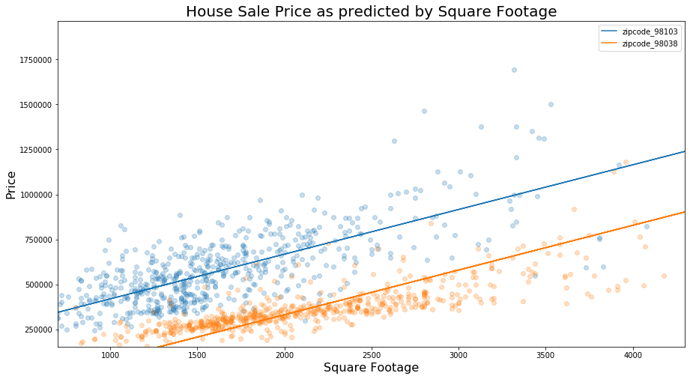
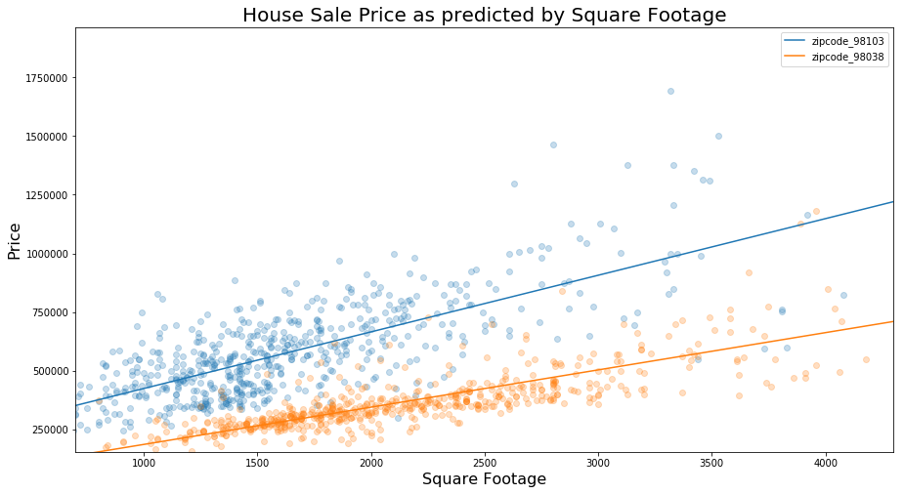
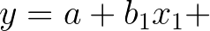
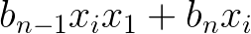
Case Study: Historical Housing Sale Data in Seattle
Varying Intercept
Varying Intercept
Varying Slope
Data source: https://www.coursera.org/learn/ml-foundations/supplement/RP8te/reading-predicting-house-prices-assignment

Slide 7
Pooling: Complete, no, and partial pooling
In the varying-slope varying-intercept, what would happen if we predicted on a new zip code?
What if we had a zip code that lacked fully representative data? I.e. imagine we were predicting the effect of waterfront on price, but had coastal zip codes without waterfront property records

Slide 8
Pooling: Complete, no, and partial pooling
Complete Pooling
No Pooling
Partial Pooling
All groups are given the same slope and intercept.
All groups are allowed to have unique slopes and intercepts.
The slopes and intercepts are related, but allowed to vary. They are assumed to come from a distribution of betas.
Group 1
Group 2
Group 3
Group 1
Group 2
Group 3
Under estimates between group variance.
Over estimates between group variance.
Bound between the extremes of complete and no pooling, pulling betas towards the mean.

Slide 9
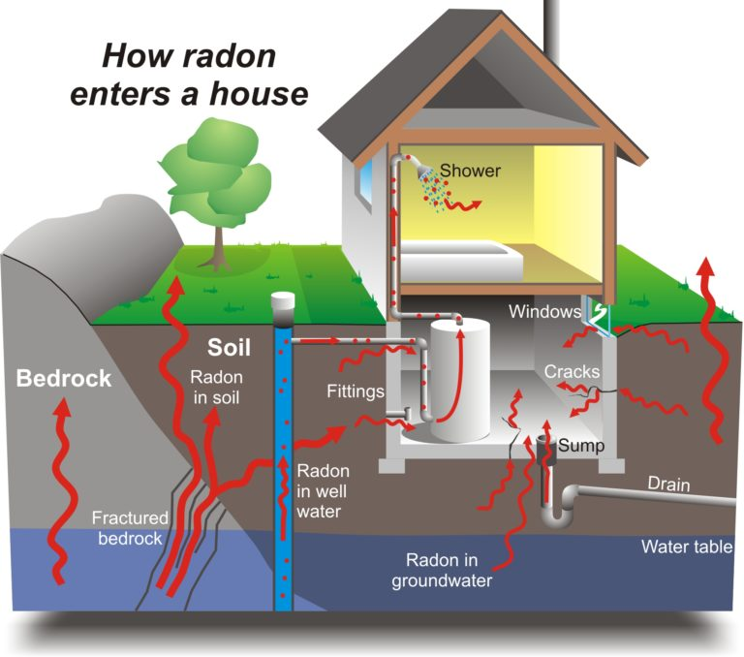
Case Study: Radon Prediction
Radon is a toxic gas that seeps into homes from the ground and is the number one cause of lung cancer outside of smoking.
Radon levels were measured across counties in Minnesota with a field denoting which floor the measurement was taken.
Not all counties had records with basement measurements
http://twiecki.github.io/blog/2014/03/17/bayesian-glms-3/

Slide 10
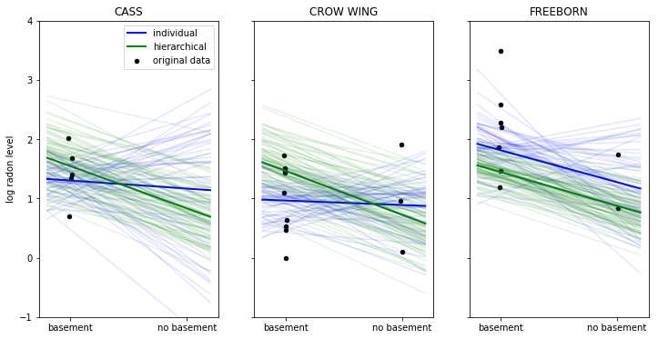
Case Study: Radon Prediction

Slide 11
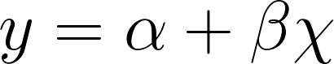
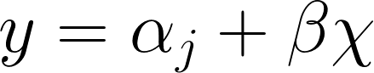
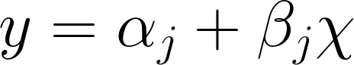
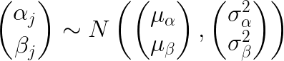
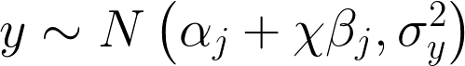
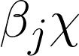
Making your model hierarchical
Simple Model
Varying intercept
Varying Slope - Varying Intercept

Slide 12
Probabilistic Models in three steps
Posit priors and declare likelihood estimator
Infer values for latent variables
Check your model

Slide 13
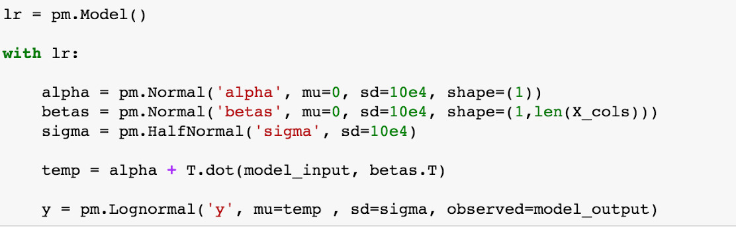
Posit priors and declare likelihood estimator
Non-informative priors can be used when no prior information is available, but all possibilities must be represented.
Notes:
Non-informative priors (wide dist, uniform from neg to pos infinity) - making sure all possibilities for betas are addressed- the likelihood estimator, shape of betas

Slide 14
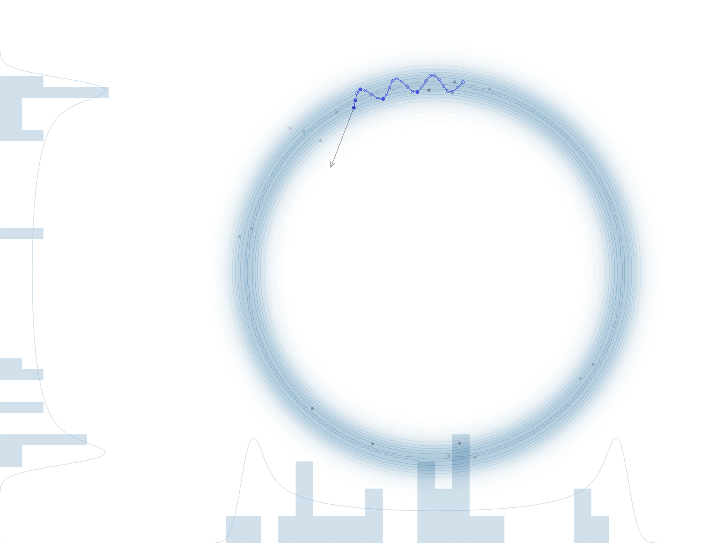
Infer Values for Latent Variables
No U-Turn Sampler
A Hamiltonian Monte Carlo Markov Chain sampler for efficient sampling
“Convergence is all about finding the typical set and then exploring the typical set” - Michael Bentacourt

Slide 15
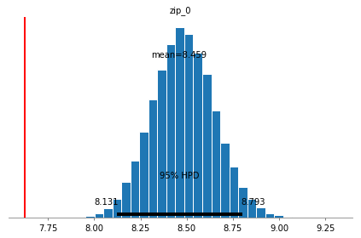
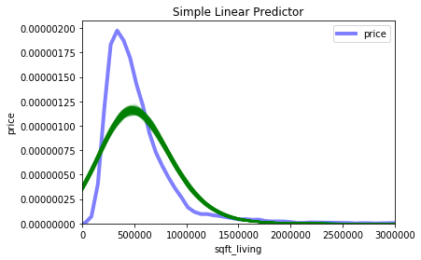
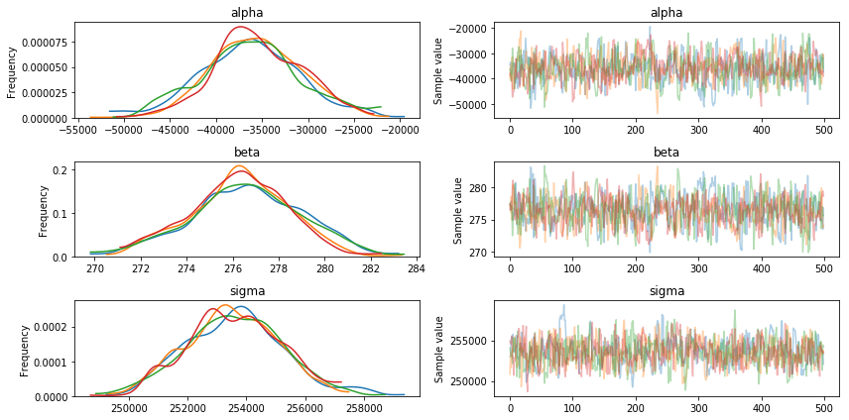
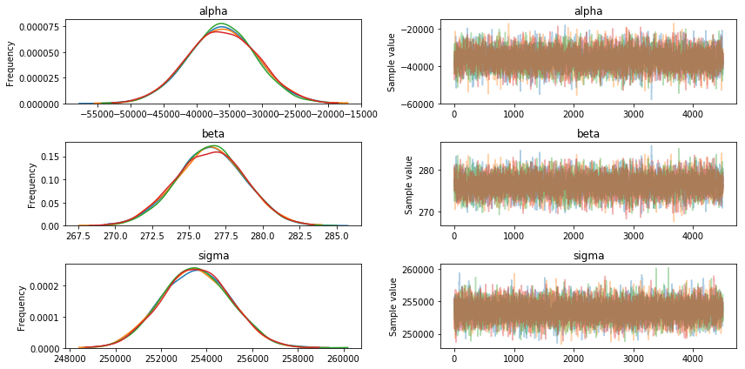
Check your Model
Is your model sensitive to initialization of new priors?
Has your model converged?
Could your actual data have come from your posterior?

Slide 16
Recap
A hierarchical model is a probabilistic model which allows for varying slope and intercepts that come from a beta distribution based on group indicators.
Probabilistic models can be generated using priors and a likelihood estimator.
When there is no prior knowledge a non-informative prior can be used.
Model health can be assessed through comparing the posterior distribution to actual data and from the sampling traceplot.

Slide 17
Putting it all Together
PyMC3 and Hierarchical models in practice

Slide 18
Making your model hierarchical
Simple Model
Varying intercept
Varying Slope - Varying Intercept

